Slide 1

A strategic approach to corporate planning, management and governance
IT Governance Conference
25 November 2009
Dr James A Robertson PrEng
James@JamesARobertson.com
Notes:
NB remember to have a chair to stand on
Make sure to take the CRITICAL FACTORS BOOK with you
An engineer with a PhD in engineering

Slide 2
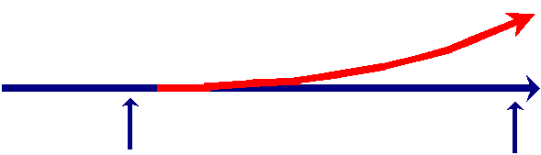
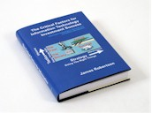
A challenge
What presentation software?
What drawing software?
What year (give or take two years)?
Minimum retrospective backward compatibility policy?

Slide 3
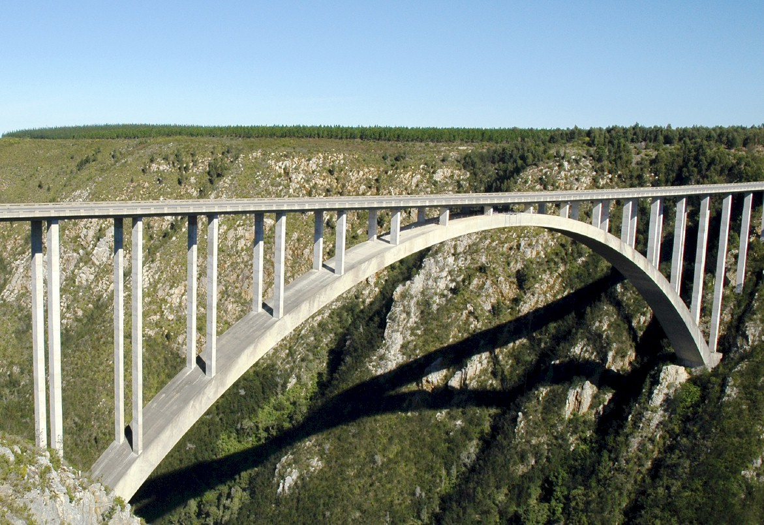
I.T. versus bridges
Notes:
In considering what i have learned as an engineer with considerable experience of the practical application of information technology i eventually realized about ten years ago that
ENGINEERS DO NOT DESIGN BRIDGES TO STAND UP – click

Slide 4
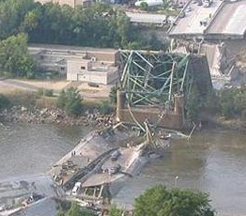
Engineers do NOT design bridges to stand up
Notes:
Who remembers this bridge collapse in Minneapolis in the middle of 2007? Within minutes it was front page news around the world – we do NOT expect bridges to fall down – if we did there would not have been anyone on that bridge that day!

Slide 5
Engineers design bridges NOT to fall down
Notes:
There is a fundamental difference in approach when one designs a bridge NOT TO FALL DOWN
Contrast this with the IT paradigm which could be called “designed to fail”

Slide 6
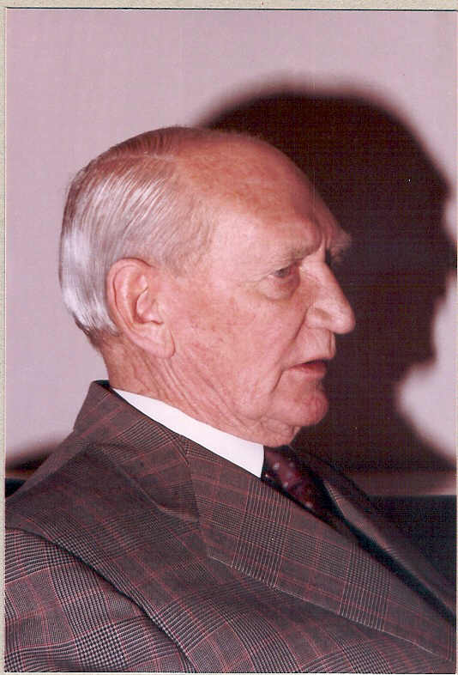
Vision
Angus Struan Robertson
Notes:
KEEP SHORT AND SIMPLE
MY FATHER
How did i get involved with computers? – my father was a visionary -- In 1981, having gathered over 7,000 pages of research data for my PhD the University mainframe did not have space to store even one page of data. My father purchased me one of the first desktop PC’s in the days of the Apple and Apricot and 123, etc – at a cost of R12,000 two and a half times my research grants! – I very quickly discovered that there was a HUGE gap between what the salesman told me the computer could do and getting it to do it – so, in that respect, NOTHING HAS CHANGED ☺ -- I then put myself through a self taught computer science programme and learned to program, learned to type and finally wrote an award winning PhD thesis – at the same time I computerized my father’s investment consulting business and we were able to double turnover in twelve months and create an enduring revenue stream that lasted for over ten years because we were able to do things that much larger businesses were not able to do – it was then that I began to understand that the strategic application of information technology COULD deliver great value and one of my greatest frustrations is the extent to which few businesses achieve this potential – the rest of this presentation is about lessons I have learned that I hope will help YOU to make a difference in your business with IT

Slide 7

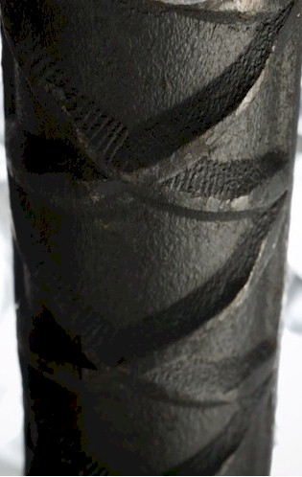


Experiencing failure

Slide 8
Governance
Governance
=
Care!
Mervyn King

Slide 9
Information technology
Notes:
KEEP SHORT AND SIMPLE
MY FATHER
How did i get involved with computers? – my father was a visionary -- In 1981, having gathered over 7,000 pages of research data for my PhD the University mainframe did not have space to store even one page of data. My father purchased me one of the first desktop PC’s in the days of the Apple and Apricot and 123, etc – at a cost of R12,000 two and a half times my research grants! – I very quickly discovered that there was a HUGE gap between what the salesman told me the computer could do and getting it to do it – so, in that respect, NOTHING HAS CHANGED ☺ -- I then put myself through a self taught computer science programme and learned to program, learned to type and finally wrote an award winning PhD thesis – at the same time I computerized my father’s investment consulting business and we were able to double turnover in twelve months and create an enduring revenue stream that lasted for over ten years because we were able to do things that much larger businesses were not able to do – it was then that I began to understand that the strategic application of information technology COULD deliver great value and one of my greatest frustrations is the extent to which few businesses achieve this potential – the rest of this presentation is about lessons I have learned that I hope will help YOU to make a difference in your business with IT

Slide 10
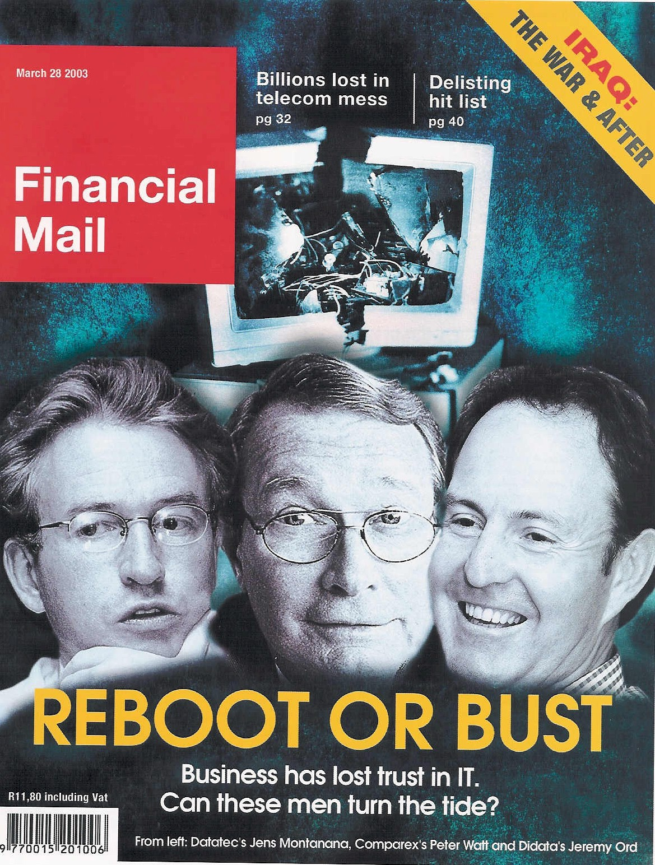

An industry in crisis
“19 out of 20 E.R.P. (business system) Implementations do NOT deliver what was promised”
Duncan McLeod
Notes:
An industry in Crisis -- Quote from Duncan McLeod, Financial Mail, 28 March 2008 -- Seven years and half a billion dollars -- Dow Chemicals Company -- $400 million – Nike -- Disney -- $878 million
-- 70% of business IT projects fail outright – another 20% materially fail to meet the business expectation – 70% of BPR projects fail and 90% of strategic plans fail to deliver

Slide 11

Business system failure can trash your business
“The next corporate disaster waiting to happen”
Richard Nolan
Notes:
Professor Richard Nolan states that "I.T. is the next corporate disaster waiting to happen”
And postulates that soon there will be an Enron level corporate failure
Do you remember Fedsure Health – tell the story SHORT

Slide 12
An industry characterized by failure
"Attendees of Gartner's Business Intelligence Summit in London last month were not surprised to hear that most enterprises are still failing to use business intelligence (BI) strategically. Gartner's survey of over 1300 CIOs returned some unimpressive findings about the state of BI implementations: Gartner's vice: president of research summed up the situation nicely by saying:
“Most organisations are not making better decisions than they did five years ago”
Computer Business Review Africa May 2005

Slide 13

Extreme failures
Seven years and half a billion dollars -- international chemicals company
$400 million -- multinational shoe corporation
Multinational entertainment giant -- $878 million
Major supermarket chain -- $195 million
Professor Rossouw van Solms

Slide 14

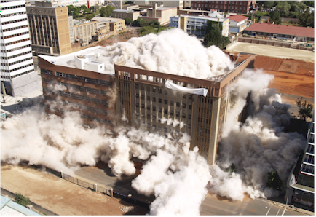
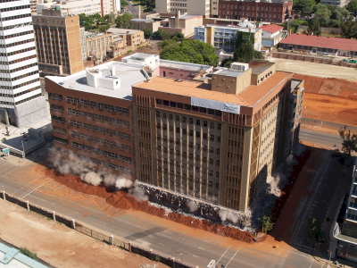
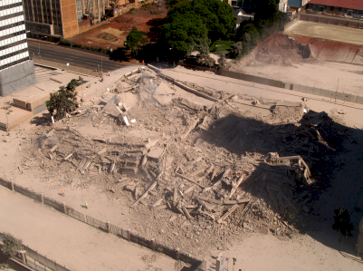
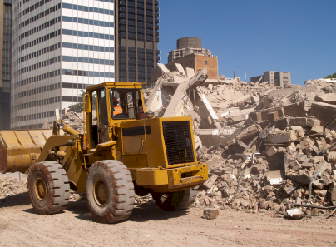
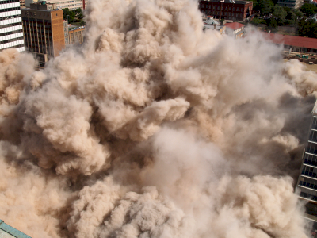
Delete or …?
Notes:
DHL, Prochem,

Slide 15
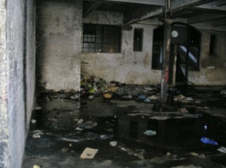
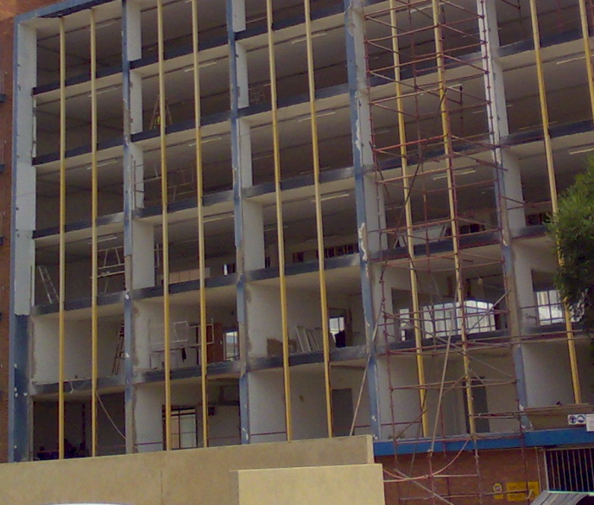
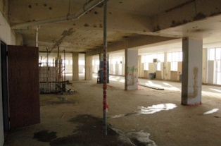
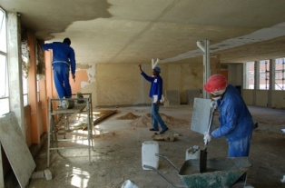


or refurbish?
Notes:
DHL, Prochem,

Slide 16
There is a need for a new approach
Notes:
There is a fundamental difference in approach when one designs a bridge NOT TO FALL DOWN

Slide 17
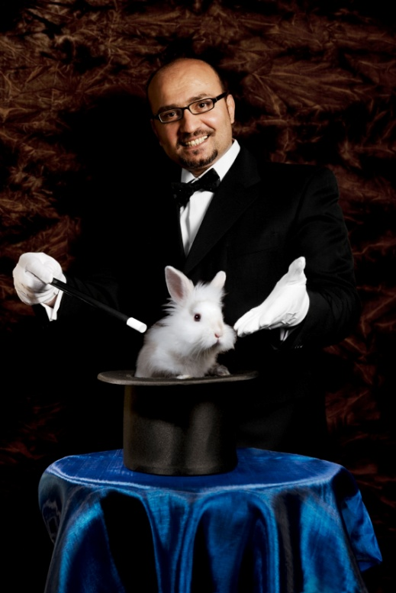

What is NOT an engineering approach?
Notes:
What is not an engineering approach? – Dramatically walk to chair – did this ever happen to you? –
WHEN SLEEPING
when i was a child i used to dream that i would stand on a chair and flap my arms and fly around the room --i have to say that that is NOT an engineering approach – as much as i may be convinced i can fly i have to say to you that were i to stand on top of a skyscraper and flap my arms and jump i would hit the ground at great speed and almost certainly die – that is NOT an engineering approach and yet many seem to think they can use software to do things magically – many are hypnotized and mesmerized by IT – are you? CLICK for rabbit out of the hat

Slide 18
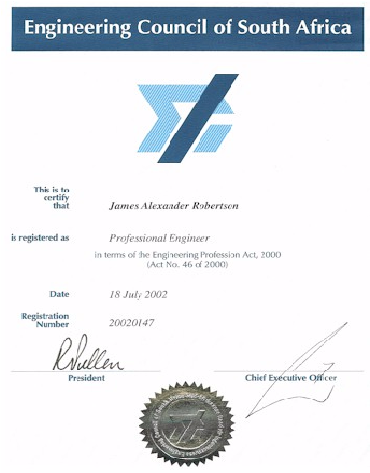

Time for a peer reviewed and moderated professional body
Voluntarily established
Statutory underpinning
License to practice
Professional indemnity insurance
Like engineers, doctors, lawyers, accountants, etc

Slide 19

There IS great opportunity
IT can and should add value

Slide 20
Adding value with IT
Motivating statements
“You produce exceptional high value outcomes in ridiculously short time frames at ridiculously low cost”
“You transformed what would have been a pedestrian, poorly thought out system, into an ERP that is already functional and will ultimately transform our analytics and IT offensive capabilities“
“You have provided some key pieces of my jigsaw puzzle, now I understand why ERP Implementations are failing”

Slide 21
Different view of ERP / IBIS
(Integrated business information systems)
Real potential of ERP software
The REAL opportunity
10
10
Common view of best practice
10
0
0
0
Notes:
DHL, Prochem,

Slide 22
Adding value with IT
A major opportunity
There are major opportunities to create more value for business
Frequently this requires the same or more expenditure
BUT in different directions

Slide 23
Notes:
WHAT CAUSES IT FAILURE?
Since 1993, analysed in 2003, course, book
Sustainable versus experimentation
People
The factors causing IT failure – in 1993 I became aware of the high failure rate of IT projects and started to talk about it – as a consequence i was asked to investigate many failed or failing projects and to help to turn them around – over the years i built up a large catalogue of the factors causing failure – in 2003 i undertook a critical issues analysis of the factors causing failure and arrived at a list of seven critical factors causing failure together with the critical factors for success which then became the subject of a course and subsequently a book – HOLD UP THE BOOK – since then i have advised many clients and led a number of significant projects and consistently validated the basic analysis
The biggest single factor causing failure is Mythology at 30% followed by lack of executive custody and inappropriate governance at 25%

Slide 24
Factors causing IT failure
Notes:
NB People
KEEP IT SHORT

Slide 25


The value of technology is determined by the person using the technology
Notes:
A gun is neither good nor bad
If it is held by a person you regard as good and pointed at a person you regard as bad the gun is good
BUT if it is pointed at YOU it is always BAD!

Slide 26

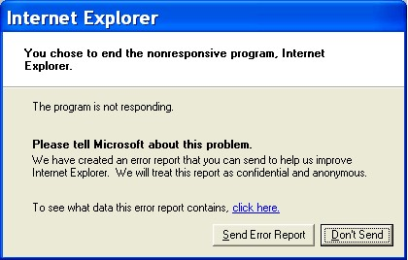
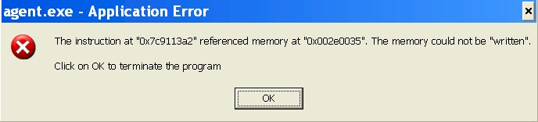
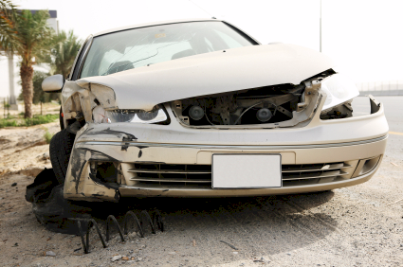
Technology is only 5% of what causes failure
Software defects CAN be prevented
Take a stand

Slide 27
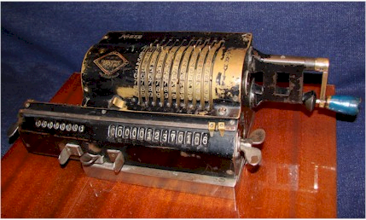



What is IT? REALLY?
The MOST important skill?

Slide 28
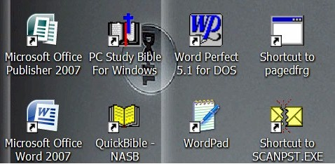


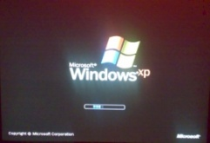
Policy
Hand-me-down principle
Long term partnership (20 years) with business system suppliers
Business focus

Slide 29
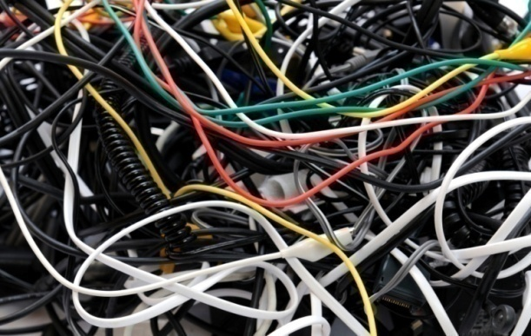
Precision configuration versus …
500528 | Waste Material Consumed
500530 | Loss from valuation of external materials
500540 | Loss from valuation of own materials
500550 | Losses - inventory variance -consignment sale
500560 | Safety Clothing
500565 | Safety Equipment
500570 | Sand & Stone
500575 | Scraper Rope
500580 | Scrapers
500585 | Services
500590 | Signs
500595 | Skips & Cages
500600 | Finished Goods Inventory Offset
500605 | Smelting & Refining
500610 | Production Order Settlement - Variance
500615 | Steel Other
500620 | Steel Sections
500625 | Steel Sheets & Plates
MOBILE PLANT
Loader’s
Dump trucks
Drill rigs
Other off road
LDV’s
etc
Lack of consistency in detail in Chart of Accounts, random mapping, difficult and costly to maintain, VERY DIFFICULT to report on strategically

Slide 30


Leadership
Executive custody is critical
  -- 50% leadership
“Business systems department” instead of “IT department”
Notes:
Make it work
It is all in a name

Slide 31
Factors for ERP reimplementation success

Slide 32

What is strategy?

Slide 33
Strategy versus tactics
Tactics – Doing things right ➔
Strategy – Doing the right things ➔
Professor Malcolm McDonald

Slide 34

Strategy versus tactics
Thrive
Tactics – Doing things right ➔
Strategy – Doing the right things ➔
Professor Malcolm McDonald

Slide 35
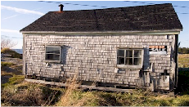
Strategy versus tactics
Tactics – Doing things right ➔
Survive
Strategy – Doing the right things ➔
Professor Malcolm McDonald

Slide 36
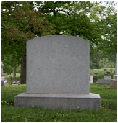
Strategy versus tactics
Tactics – Doing things right ➔
Die
Strategy – Doing the right things ➔
Professor Malcolm McDonald

Slide 37


Strategy versus tactics
Die fast
Tactics – Doing things right ➔
Die slowly
Strategy – Doing the right things ➔
Professor Malcolm McDonald

Slide 38
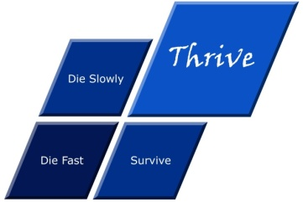
Strategy versus tactics
Die fast
Thrive
Tactics – Doing things right ➔
Die slowly
Survive
Strategy – Doing the right things ➔
Professor Malcolm McDonald

Slide 39
The essence of strategy
create competitive advantage
The essence of strategy is integration - the ability to see in a complex holistic way
Michael E Porter: Global Competitive Strategy : 9 June 2003

Slide 40
Michel Robert
strategic driving force
Product
User
Market
Technology / Know-How
Production Capacity or Production Capability
Sales / Marketing Method
Distribution
Natural Resources
Size / Growth
Profit
Every organization should have ONLY ONE of these as driving force
the others are managed within the context of the strategic driving force
Michel Robert

Slide 41
What is strategy?
The essence of why an organization exists and how it thrives

Slide 42
Essential components of strategy
What is critical to YOUR organization
Compare:
  Pick ‘n Pay
  Edgars
  Woolworths
Core economic driver
Core human resource driver
Core market differentiator / value proposition / sales or marketing method
Core customer / market / user
Core asset / product / natural resource / size / growth
Core technology / capability / know-how / distribution
Core values
Other

Slide 43
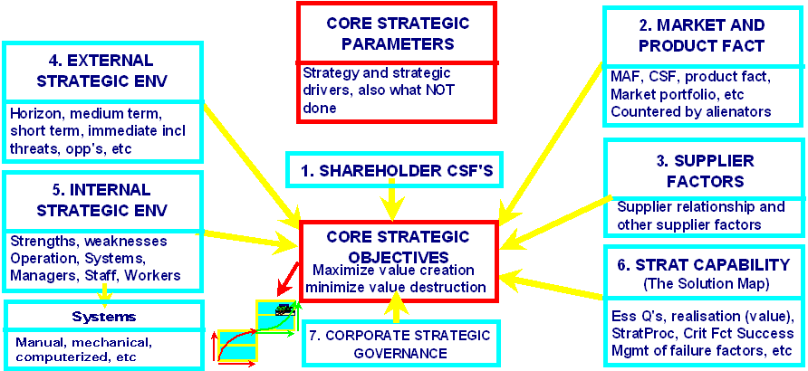
The strategic environment

Slide 44
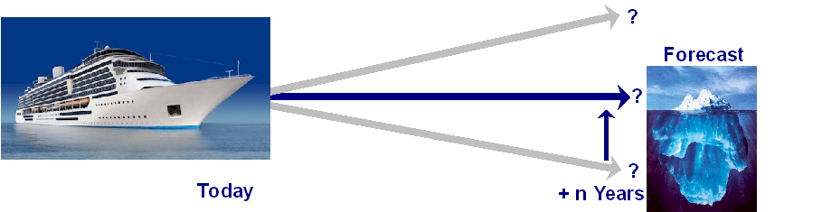
The time dependency of strategy
NOT a forecast
Professor Malcolm McDonald

Slide 45
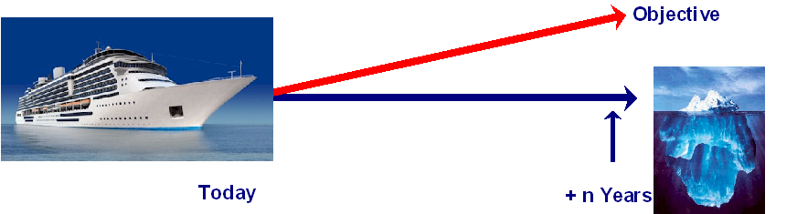
The time dependency of strategy
NOT an objective
Professor Malcolm McDonald

Slide 46
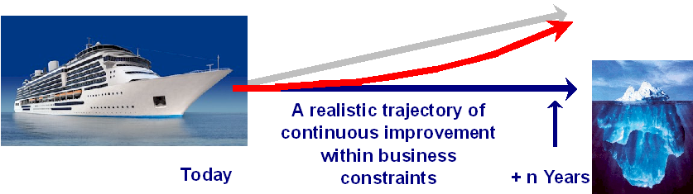

The time dependency of strategy
Strategic plan – the path to competitive advantage
Systems must be optimally designed, configured, implemented and operated from the start in order to achieve a high value outcome
– design for the future

Slide 47
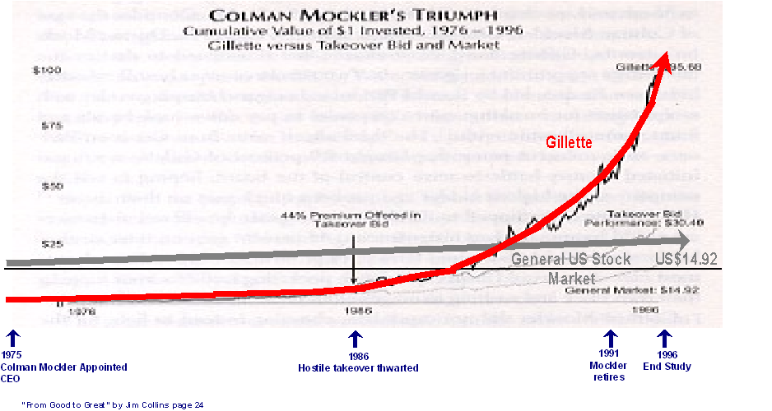
The trajectory from Good to Great
Jim Collins

Slide 48

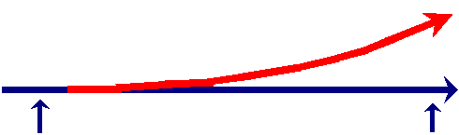
Historical differentiators
60's Production
70's Sales
80's Finance
The 90's and 2000's and …
  Excess supply
  Single division cannot solve
  Integrated operation is critical
  A boom is unlikely!!
Strategic issues are vital
ERP should play a vital role
We are NOT there YET!
Adapted from Professor Malcolm McDonald, Peter Laburn and Iain Peters

Slide 49

Future differentiators
The key differentiators beyond 2000
Market focused strategy
Utilization of people
Effective management decision making
ERP should play a vital role
The information to support the essence of the business
We are NOT there YET!
World Competitiveness Report, McDonald and others

Slide 50
Measures of strategic delivery
Increased competitiveness
Increased market share and resulting turnover
Increased profit margins
Increased earnings
Increased shareholder value
etc
Determined by business executives and shareholders
Thrive

Slide 51




Value
Experienced / defined by people
Intuitive / gut feel
Transaction = exchange of value between recipient and provider
NOT money / cash / finance
Money
  is a medium of exchange / proxy / surrogate for value
    a means of measurement
      therefore easy to measure

Slide 52
Economic value
Measuring the money is not really that important
Find ways to measure the value that REALLY generates the money
and there WILL be money
A huge need
  and a huge opportunity

Slide 53
Developing a robust strategic budget
What is required for a valuable outcome
Add value
    to a customer who is willing to pay
Materially and sustainably reduce operating costs
    AND do NOT destroy value in another way (e.g. morale or loyalty)
Enable the creation of a product or service that currently does not exist
    for a customer who is willing to pay
Defend, extend or create competitive advantage
    for a customer who is willing to pay
Can you relate your IT Governance to an external customer who is willing to pay?

Slide 54
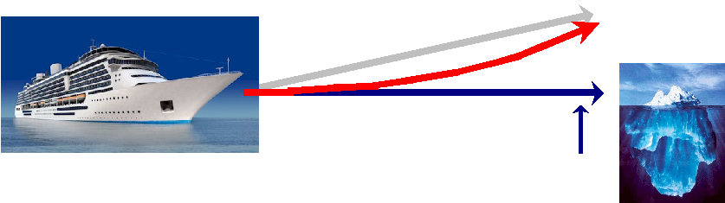
Strategic plans must be future focussed
Budget for the future
Projects are the mechanism whereby we bring about change
IT investments MUST be future focussed
Is your governance future focussed?

Slide 55

Analysis and design for “doable” plans
How to determine the right things
Analysis of strategic environment, context, requirements, benefits, value, etc
Strategic gap analysis
Strategic design
Strategic governance framework
Strategic action plan
Strategic project management
Strategic plan business outcome auditing, monitoring, performance measurement and incentives
Continuous strategic improvement

Slide 56
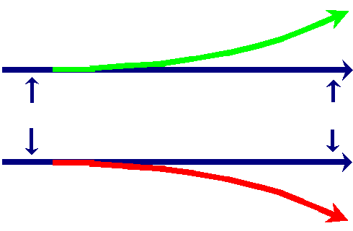
Analysis
determine the right and wrong things
Thrive
All factors that impact significantly on the business
The critical factors = the right factors = the strategic factors
Prioritised and quantified to support decision making
Ask the "right questions" in order to obtain the "right" answers
Enhance / create right things
}
Gap
}
Gap
Reduce / eliminate wrong things
Die

Slide 57
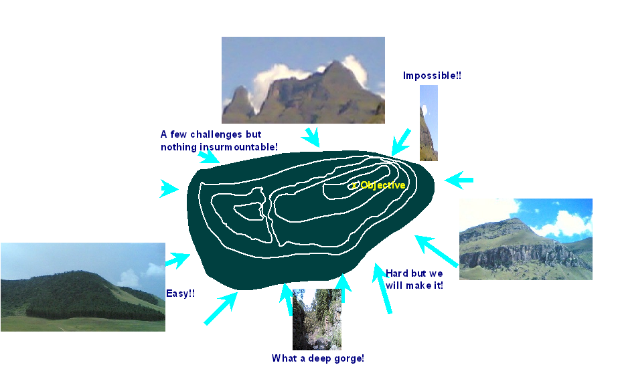
Different views of the mountain

Slide 58
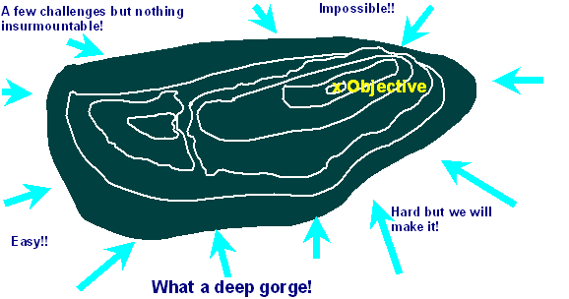
Determining the critical components
Everyone sees the problem and the solution differently
- Executive
- Production
- Operations
- Marketing
- Finance
- etc
Strategic clarity provides focus
Different perspectives are a major challenge – facilitate change

Slide 59
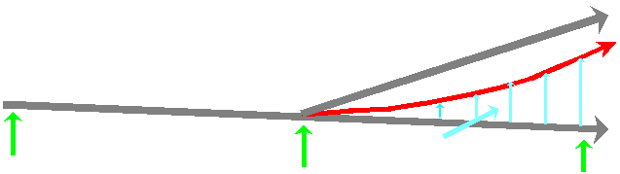
Gap analysis -- projects / activities / components
What will be done?
How well are we doing it already?
Accountability
Timeline
Objective
Strategic plan
outcome of
process
Forecast
Projects and activities to close the gap MAY include IT
Minus n years
Today
Plus n years

Slide 60
Gap analysis -- projects / activities / components
Executive management is often the most serious constraint
-- ask the RIGHT questions
-- what is REALLY required?
Resources (costs and constraints)
Risks
Customer impact
What value and how -- economics
Example
Objective
Strategic plan
outcome of
process
Forecast
Projects and activities to close the gap MAY include IT
Minus n years
Today
Plus n years

Slide 61

Identify the organizations strategic drivers and then strengthen them
Thrive
Tactics – Doing things right ➔
Strategy – Doing the right things ➔

Slide 62
A challenge – again ☺
What presentation software?
What drawing software?
What year (give or take two years)?
Minimum retrospective backward compatibility policy?
Not important (PowerPoint 2007)
Harvard Graphics
1993
ditto

Slide 63
Summing up
A strategic approach to corporate planning, management and governance
Align your IT governance with the essence of why the organization exists and how it thrives -- strategy
Plan for future strategic growth
Design against failure in order to succeed
Information longevity through application continuity
Take another look at how IT is led versus governed
Structured strategic analysis, design, plans and budgets
Culture of continuous, strategically harmonious improvement

Slide 64

Call to action
What is your single most important insight from this presentation?
What is the single most practical action that you can take tomorrow to apply I.T. more effectively?
If you do not act within 48 hours you probably never will – act TODAY! ☺
James@JamesARobertson.com
Telephone: ++27-(0)83-251-6644

Slide 65

Design IT governance like bridges ...
To last
Psalm 136:5 "To Him who by wisdom made the heavens, for His mercy endures forever;"

Slide 66

Questions?
Remember to design against failure!
Dr James Robertson PrEng
James A Robertson & Associates
Telephone: ++27-(0)86-111-5409
/ ++27-11- 782-5996/7
Cell: 083-251-6644 (preferred)
Fax: ++27-(0)86-540-0178
P O Box 4206, Randburg, 2125,
South Africa
www.JamesARobertson.com
email: James@JamesARobertson.com
Email me at the above address for a free electronic copy of my book

